Slide 1

AARON HARTMAN | CREATIVE

Slide 2



CREATIVEBREIF
Presentation
AARON HARTMAN | CREATIVE
2025

Slide 3



AARON HARTMAN
INTRO
DUCTION
INTRODUCING OUR CREATIVE VISION
AARON HARTMAN | CREATIVE

Slide 4


CREATIVE OVERVIEW
UNLEASH CREATIVITY IN DESIGN SOLUTIONS
AARON HARTMAN | CREATIVE

Slide 5
DESIGN PRINCIPLES
Pattern
aesthetic
Scale
hierarchy
Color theory
WHITE SPACE
CONTRAST
Repetition
Emphasis
Movement
Proportion
Balance
Rhythm
ALIGNMENT
HIERARCHY
Proximity
Space
VARIETY
UNITY
DOMINANCE
AARON HARTMAN | CREATIVE

Slide 6


UNDERSTANDING
CREATIVE NEEDS
OBJECTIVES, MVP, AND AUDIENCE
AARON HARTMAN | CREATIVE

Slide 7
UNDERSTANDING
OBJECTIVES
CREATIVE NEEDS
  What is the primary goal of this task or campaign? (e.g., increasing New accounts, boosting awareness, driving traffic)
  WHAT ARE THE KEY PERFORMANCE INDICATORS (KPIS) FOR SUCCESS?
  WHO IS THE TARGET AUDIENCE? (E.G., DEMOGRAPHICS, PSYCHOGRAPHICS, EXISTING MEMBERS, POTENTIAL NEW MEMBERS)
AARON HARTMAN | CREATIVE

Slide 8
BRAND AND MESSAGING
UNDERSTANDING
CREATIVE NEEDS
  How does this align with True Sky’s overall mission and values?
  WHAT IS THE DESIRED TONE OR VOICE FOR THIS PROJECT? (E.G., FRIENDLY, PROFESSIONAL, EMPOWERING)
  ARE THERE SPECIFIC MESSAGING THEMES THAT SHOULD BE FOLLOWED?
AARON HARTMAN | CREATIVE

Slide 9
DETAILS AND DELIVERABLES
UNDERSTANDING
CREATIVE NEEDS
  How will this be used? (E.G.ITM’s, poster, or ad)
  WHAT IS THE SIZE OF SAID DILIVERABLE?
  IS THERE A SPECIFIC FILE ARCHITYPE NEEDED FOR THIS AD?(E.G. PNG, PDF, JPG, AI, PSD, INDD...ETC)
AARON HARTMAN | CREATIVE

Slide 10


DESIGN
PROCESS
CRAFTING VISUAL EXCELLENCE
Unveil our design process, from research and sketching to iterations and finalization, emphasizing our attention to detail and dedication to quality.
AARON HARTMAN | CREATIVE

Slide 11



CREATIVE CONCEPT
DEVELOPMENT
FROM IDEA TO CONCEPTUALIZATION
In this phase, we transform abstract ideas into tangible concepts, leveraging our creative expertise and innovative thinking. Our goal is to translate client objectives into compelling visual narratives that resonate with the intended audience.
1. BRAINSTORMING SESSIONS.
4. APPROVAL OF CONCEPT
2. IDEATION AND CONCEPTUAL SKETCHES.
5. BULK CREATION OF ALL DELIVERABLES
3. FEEDBACK AND ITERATIONS.
6. SENDING TO PRINT/POSTING TO MEDIA SOURCES.

Slide 12
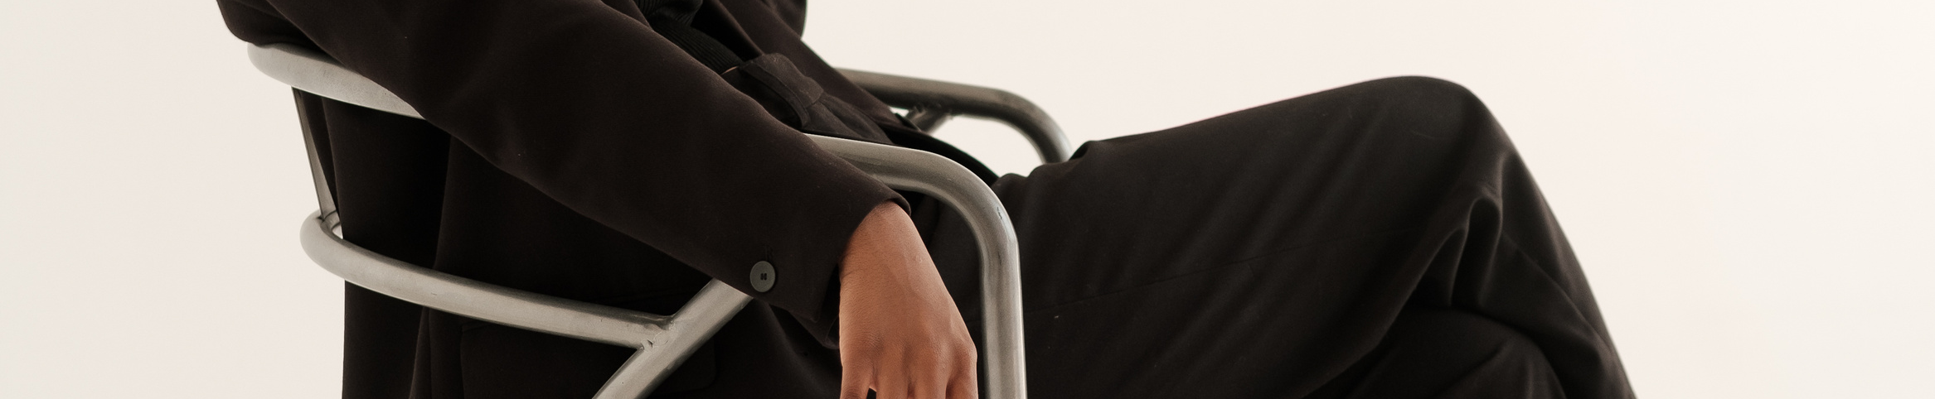
CAMPAIGN/CREATIVE
Our objective is to underscore our products, and unique services that give us a competitive edge in the market. To showcase what truly makes us different from every other credit union or bank. Gather data, and adjust as we go.
ANALYSIS
AARON HARTMAN | CREATIVE

Slide 13

DESIGN
TIMELINE
Campiagns should be completed and waiting to be delivered a full quarter in advance.
  Prepped. Prepared. and Ready
  From reationary to proactive approach
  Time to adjust plans.
The imagery we use will consistently reflect the seamless blend of Brand and Psychographics.

Slide 14
TIMELINE
PRIORITY
Priority:
Legal Litigation prevention
Campaign Tasks
Social Media Posts
Marketing Request board

Slide 15


CREATIVE
Our creative concept, "Design Studio," encapsulates our vision using phychographics, and our voice to conviegh our message.
CONCEPT
The goal is to utilize psychographics and our rich heritage to craft a narrative that connects deeply with our audience. By showcasing our products and services as both innovative and rooted in tradition, we aim to inspire trust, loyalty, and a lasting sense of connection.

Slide 16


KEY
PEACE OF MIND
TRUSTWORTHY
FREEDOM
MESSAGES
Our key messages - Peace of Mind, Trustworthy, Freedom, and Innovative - encapsulate the essence of True Sky.
We aim to convey these messages effectively through our marketing and design endeavors. We can do so with using psychographics.

Slide 17
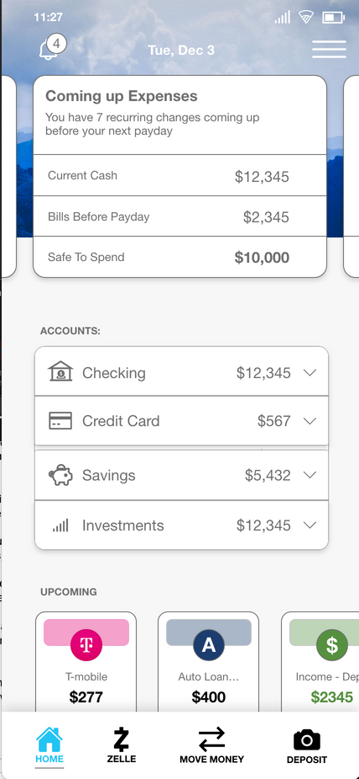

NEW APP CONCEPT
Scan the code to preview the app

Slide 18


PLATFORMS AND CHANNELS
Our marketing strategy is to expand our reach to various platforms:
Currently
our website, traditional marketing, email marketing campaigns, and social media, Cox Media, and NEXT.
Goal:
Streaming Services, Influencer partnerships, App Rebrand, and an eagerly awaited Sky Connect launch.

Slide 19
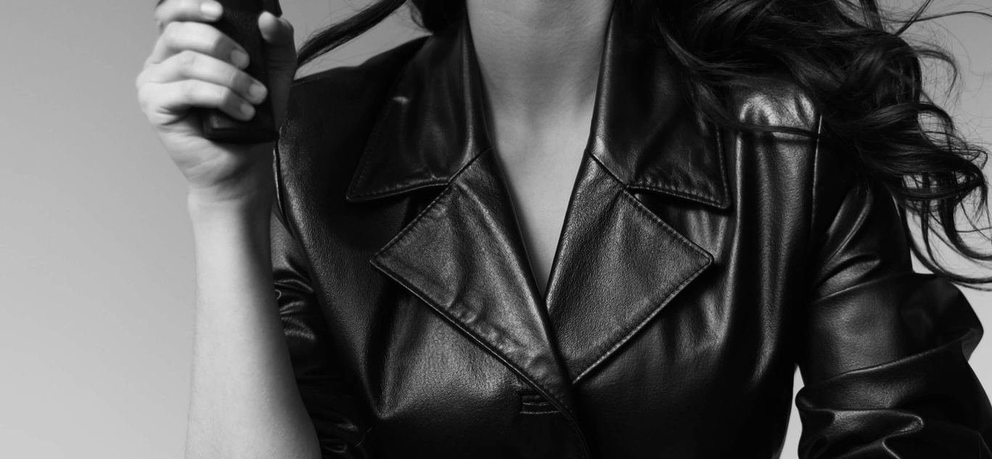
NEXT
STEPS

